Slide 1
LL Parsing Table
Team :
K.Sreevarun – 2010030451
k.Manichand – 2010030455
b.Jashwanth – 2010039002
b.Anil kumar - 2010030015
b.Avinash - 2010030358

Slide 2
Outline
Introduction to LL Parsing
Table Constructing an LL Parsing
Table Advantages of LL Parsing
Table Limitations of LL Parsing
Table LL(1) Parsing Table
Conclusion
Execution outcome

Slide 3
Introduction to LL Parsing Table
LL parsing is a type of top-down parsing that uses a left-to-right scan of the input and a leftmost derivation.
A parsing table is used in LL parsing to determine which production rule to apply at each step of the parse.

Slide 4
Constructing an LL Parsing Table
To construct an LL parsing table, first create a set of FIRST and FOLLOW sets for each non-terminal symbol in the grammar.
The FIRST set contains the terminal symbols that can start a string derived from the non-terminal symbol, while the FOLLOW set contains the terminal symbols that can follow the non-terminal symbol in a valid string.
Next, for each production rule A -> alpha, add the rule to the LL parsing table for each terminal symbol in the FIRST set of A.
If epsilon is in the FIRST set of A, add the rule to the LL parsing table for each terminal symbol in the FOLLOW set of A.
If there is a conflict in the LL parsing table, the grammar is not LL(1) and cannot be parsed using LL parsing.

Slide 5
Advantages of LL Parsing Table
LL parsing has several advantages over other parsing techniques. It is easy to implement and efficient for small or medium-sized grammars.
Additionally, LL parsing can handle left-recursive and ambiguous grammars with some modifications.

Slide 6
Limitations of LL Parsing Table
Despite its advantages, LL parsing has some limitations. It cannot handle all types of grammars, such as those with left recursion or ambiguity that cannot be resolved by lookahead.
In these cases, other parsing techniques like LR parsing may be more appropriate.

Slide 7
LL(1) Parsing Table
An LL(1) parsing table is a special type of LL parsing table that can handle a larger class of grammars.
It requires that the grammar is non-left recursive and unambiguous, and that there is at most one production rule for each non-terminal symbol and input symbol pair.
To construct an LL(1) parsing table, follow the same steps as constructing a regular LL parsing table, but also check for conflicts between FIRST and FOLLOW sets.
If there is a conflict, the grammar is not LL(1) and cannot be parsed using LL(1) parsing.

Slide 8
Conclusion
The LL parsing table is a useful tool for implementing LL parsing and understanding the behavior of an LL parser.
It can be constructed manually or automatically using an LL parser generator, and it requires a set of FIRST and FOLLOW sets for each non-terminal symbol in the grammar.

Slide 9
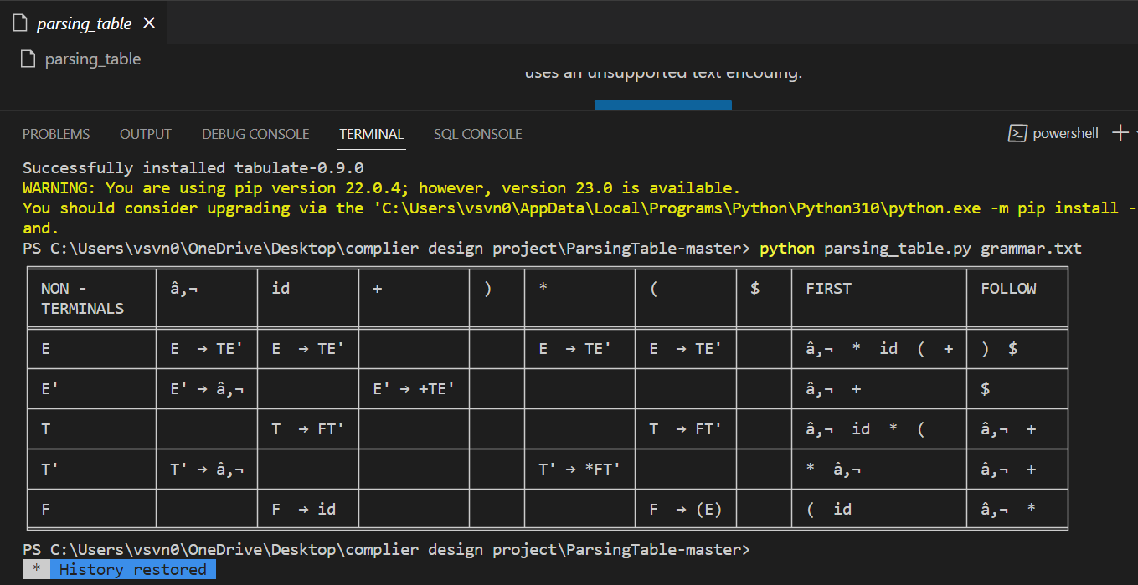
Execution Outcome: -

Slide 10
THANK YOU

